Slide 1

Employee Data Analysis using Excel
STUDENT NAME: DEVI BALA.S
REGISTER NO: 312201097 asunm110312201097
DEPARTMENT:B.Com ACCOUNTING and FINANCE
COLLEGE: DRBCCC HINDU COLLEGE -PATTABIRRAM

Slide 2

Employees Salary Analysis using Excel

Slide 3


AGENDA
Salary
Salary survey
Executive Summary
Methodology
Salary structure overview
Current Salary structure
Industrial salary structure
Result and discussion
Conclusion
3/21/2024 Annual Review

Slide 4

Salary
A salary is a fixed amount of money or compensation paid to an employee by an employer in return for work performed. Salary is commonly paid in fixed intervals, for example, monthly payments of one-twelfth of the annual salary.
Salary is a form of periodic payment from an employer to an employee, which may be specified in an employment contract. It is contrasted with piece wages, where each job, hour or other unit is paid separately, rather than on a periodic basis.
Salary can also be considered as the cost of hiring and keeping human resources for corporate operations, and is hence referred to as personnel expense or salary expense. In accounting, salaries are recorded in payroll accounts

Slide 5

Salary survey
Salary survey, also known as a market survey, is a research study that collects and analyzes salary and wage data.
Salary surveys can be organized by location, industry, company size, and other factors.
The purpose of a salary survey is to help employers and employees understand what different jobs pay in different areas, and to identify trends in wage and salary levels.

Slide 6

Executive Summary
This Salary Analysis Report provides an in-depth review and comparison of salary structures within the industry to guide in making informed compensation decisions that are both competitive and equitable.

Slide 7

II. Methodology
Data Analysis Techniques
Data collection

Slide 8
A.Data collection
Data collection Data collection is the process of gathering and measuring information on variables of interest, in an established systematic fashion that enables one to answer stated research questions, test hypotheses, and evaluate outcomes.
Some data collection methods include
surveys,
interviews,
tests,
physiological evaluations,
observations,
reviews of existing records, and
biological samples.

Slide 9

B.Data Analysis Techniques
Data analysis has two prominent methods:
qualitative research
quantitative research.
Each method has their own techniques. Interviews and observations are forms of qualitative research, while experiments and surveys are quantitative research.
3/21/2024 Annual Review
9

Slide 10
Salary structure overview
Data Preparation
A salary structure, also known as a compensation structure or pay structure, is a framework that outlines how an organization pays its employees. It’s a hierarchical system that groups jobs into pay grades or ranges based on their value to the organization and in the external market.
A salary structure helps ensure that pay is fair, consistent, and competitive with industry standards. It also helps organizations attract, retain, and motivate talented employees.
Pay structure is the way a company organizes its workers’ pay. This can relate to how pay is determined on either an: organizational level, like through salary bands and market benchmarking.
10

Slide 11
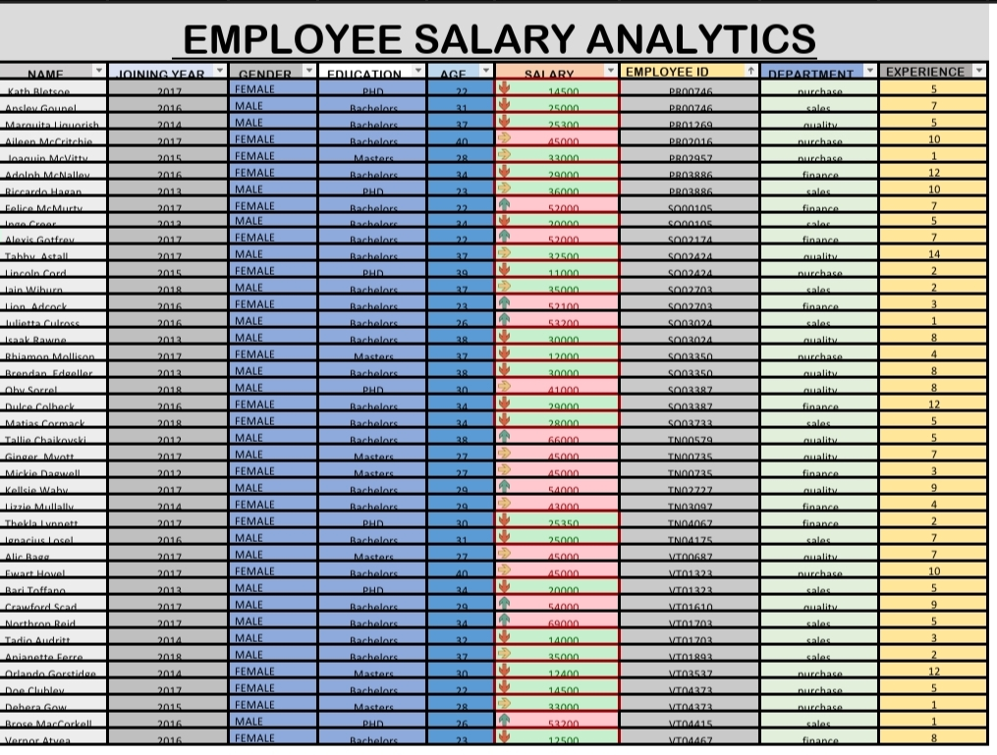
Current salary structure
11

Slide 12
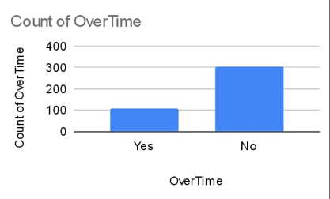
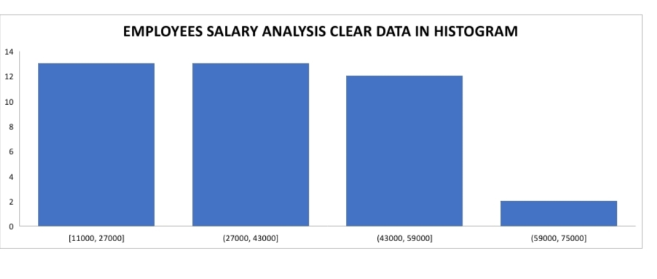
RESULTS
12

Slide 13
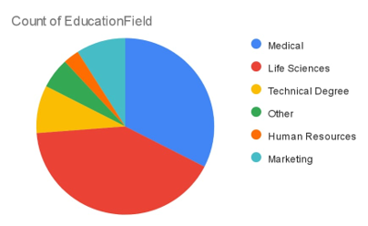
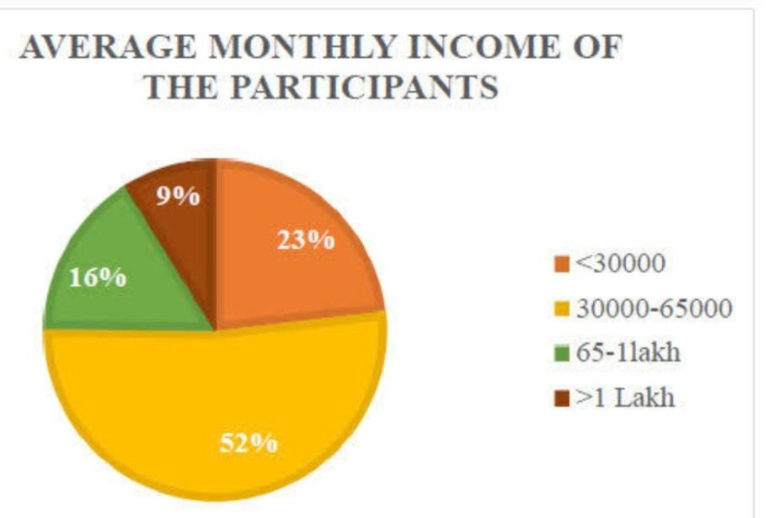
RESULTS OF SAMPLE SALARY
13

Slide 14
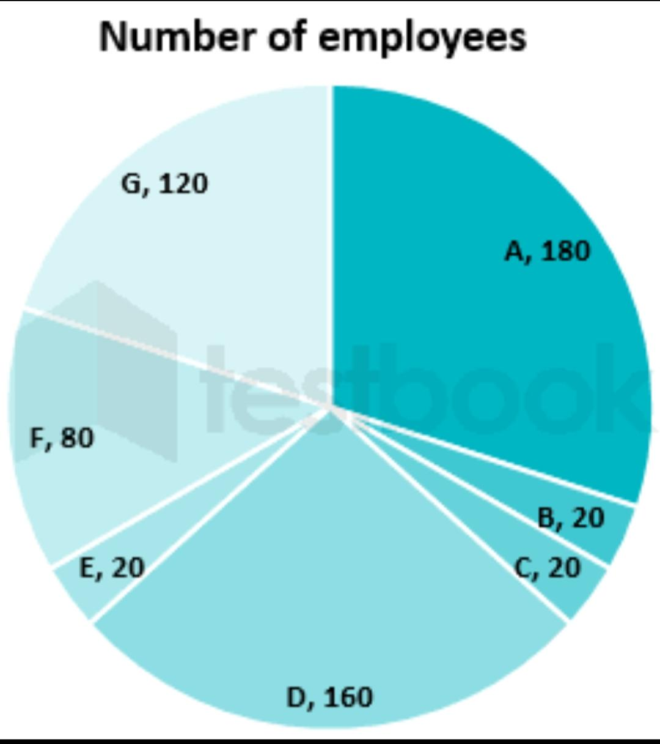
RESULTS OF SAMPLE SALARY
14

Slide 15
conclusion
SALARY IS NOT SOMETHING WE SHOULD IGNORE, even though many of us might not want to spend too much time dwelling on money matters or worrying that we don’t make enough. The commonly accepted rule that it is not appropriate to share information about your salary with colleagues has reasonable justification.
A salary range structure (or salary structure) is a hierarchal group of jobs and salary ranges within an organization. Salary structures often are expressed as pay grades or job grades that reflect the value of a job in the external market and/or the internal value to an organization.

